Slide 1
Mashup-based Mobile App Inventor
Huajun Chen
Zhejiang University

Slide 2
Outline
Motivation
Current Progress
Future Vision
Demonstration

Slide 3
Motivation
Why and What is Mashup-based Mobile App Inventor?

Slide 4




Mobile Apps: more and more important in our daily life
App Number By Jan, 2011
Growth of App Number in 2010
Notes:
@ Development of mobile internet and mobile capability; Role of mobile internet in people’s life.

Slide 5
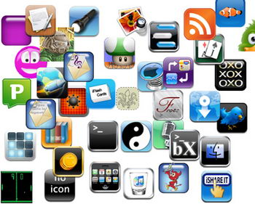





Trends: Cloud based mobile apps
Most apps live in Clouds.

Slide 6
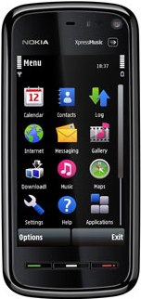
Mobile mashup: mashups for mobile app
Contacts
GPS
Flickr
Google Maps
Photos
Amazon
Youtube
Facebook
Twitter
Music
…
LinkedIn
Videos
Mashup all kinds of data sources upon a common interface
Location based, Contacts based, Personal Gallery based, …
Social Mashups
Music Mashups
News Mashups
Shopping Mashups
Notes:
@ The potential of introducing mashup into mobile internet.

Slide 7
Mashup-based mobile app vs general mobile app
Mashup-based Mobile App
Data API
Data API
Logic
…
Data API
Logic
Logic
…
General Mobile App
Mashup-based Mobile App
A Special type of cloud-based App.
Focus on APIs’ interaction with restricted logic.
General Mobile App
Focus on logic of app with no or numbered APIs.
VS
Notes:
@ Mashup-based Mobile App

Slide 8
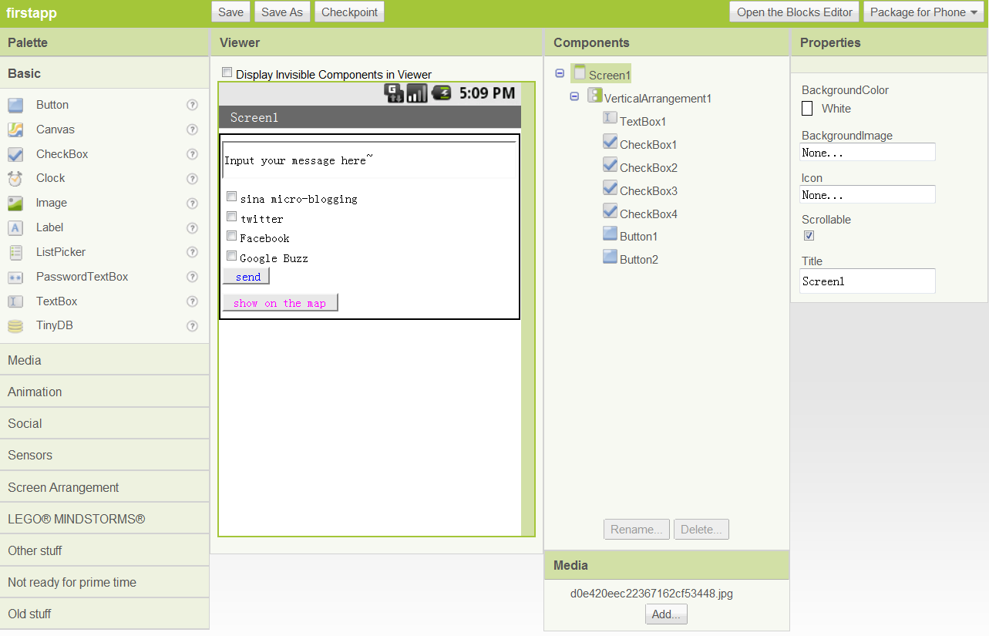
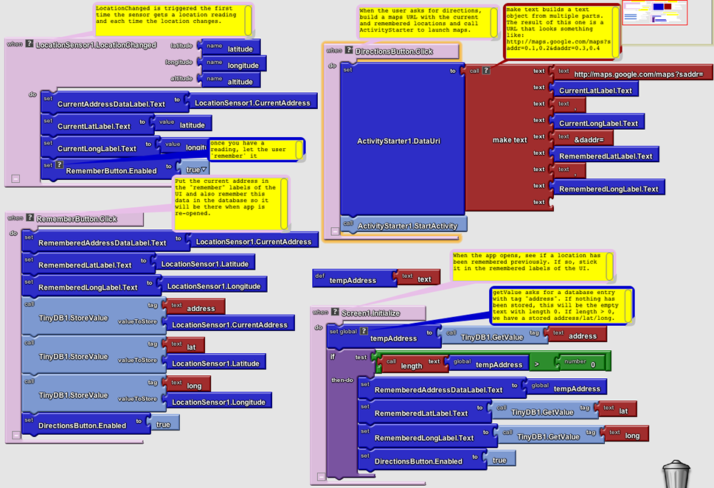
Google App Inventor
UI Designer
To use App Inventor, you do not need to be a professional developer.
Instead of writing code, you visually design the way the app looks and use blocks to specify the app's behavior.
Logic Designer
Notes:
@ Google App Inventor

Slide 9

Design of mashup-based mobile app inventor
Mobile Services
Web Services
Mashup-based Mobile App Inventor
App Ideas
Installation File
This is what we are looking for!

Slide 10
Current progress
A Demo Implementation with Symbian Platform

Slide 11
Architecture
OWL-S Service Repository
Service Invoking Fragments
Recommendation
Mashup-based Mobile App Inventor
Reasoner
Service Invoking Code
Mobile App Installation Bundles
Mobile Mashup App Ideas
Mashup Designer
Mashup Configuration
Mashup Interpreter
App Compiler
Mashup Graph
XML
Description File
Javascript Object
Download
Flow Control Structures
Project Files
UI
Server
Qt Project Template
Notes:
@ A platform like Google App Inventor

Slide 12
Two generators we implemented
Mashup generator
OWL-S based service repository
Mobile app generator
Mashup interpreter
Execution engine
Recommendation module
User Interface
App complier
Notes:
@ Architecture of the platform (from the paper or PPT)

Slide 13
Snapshot of implemented system
Notes:
@ Snapshot of the platform (from the paper) address: www.dart.zju.edu.cn/mobileMashup/Mashup.html

Slide 14
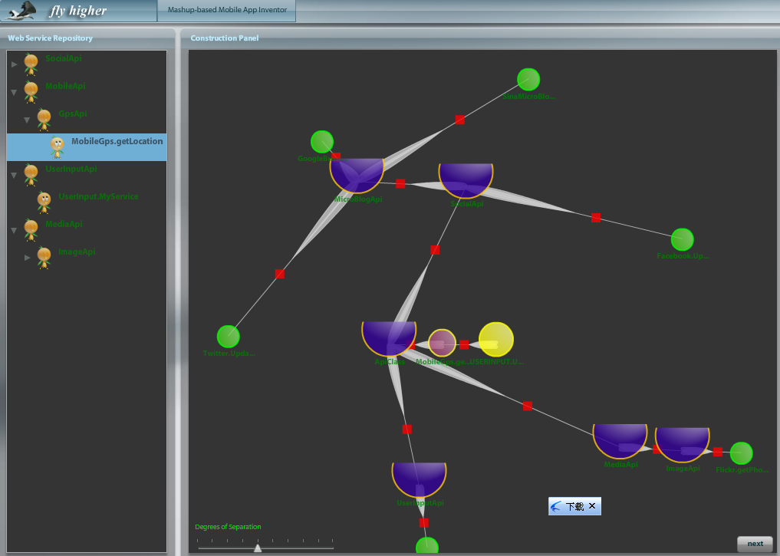
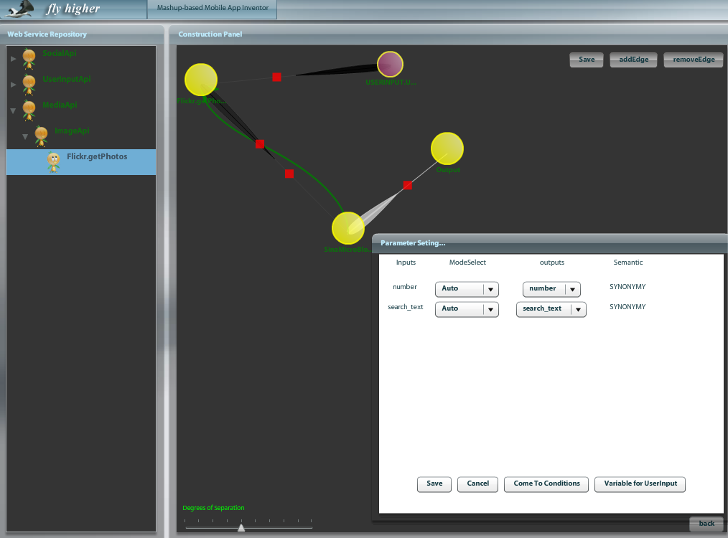
Web browser based User interface
Mashup Graph Construction
Mashup Logic Configuration

Slide 15
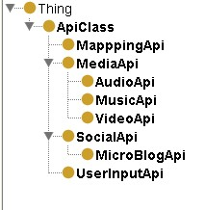
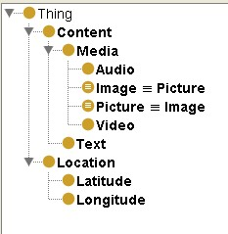

Owl-s based service repository
API class hierarchy
concepts class hierarchy
Functions of OWL-S
Automatic Web service discovery
Automatic Web service invocation
Automatic Web service composition and interoperation
Profile ontology and its attributes
Notes:
@ Semantic-based service repository management

Slide 16
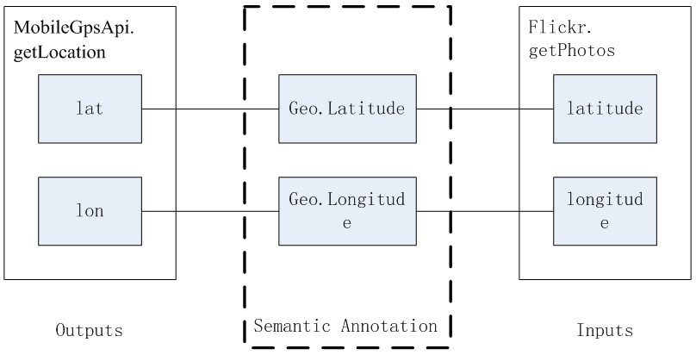
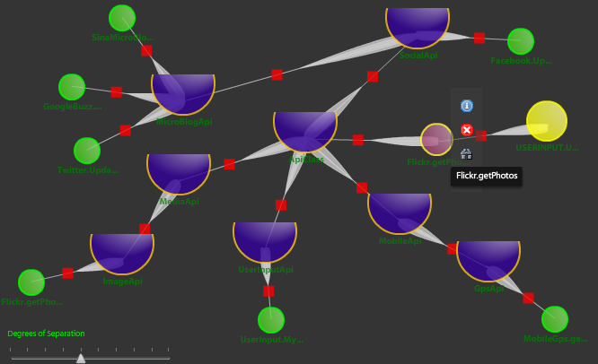
Recommendation module
Implemented:
Parameter matching based recommendation
In consideration:
Trace-based mashup recommendation
Voronoi-based mashup recommendation
Parameter matching based recommendation
Recommended service node
Target service node
Hierarchical service classification

Slide 17
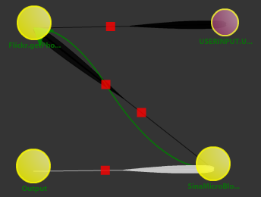
Structured Mashup
Flow Control Structures
Three basic structures: sequence, selection, repetition.
Variables
User can define variables in either global or local way.
Loop line
Click to configure linkage and conditions
Notes:
@ Structured Mashup; Workflow ideas.

Slide 18
Mobile MASHUP Code generator
Mashup Source File
Mashup Compiler
Mashup Validator
Syntax Validation
Semantic Validation
Mashup Source File
Mashup Code Generator
Mashup Description File

Slide 19
Mobile mashup app execution engine
Deal with user input and control
Execution Engine
Control execution of workflow
Symbol Table Management
Flow Controller
Service Invoker
User Interaction
Call remote web service
Manage domain of variables
Interruption and Recovery
Manage pausing and continuing of execution
Qt Framework
Symbian Platform

Slide 20
Mobile mashup app generator
Mashup Source File
Mobile App Compiler
Mashup Compiler
Mashup Validator
Mashup Source File
Mashup Description File
Mashup Code Generator
QT-based App Installation File
Code for Mashup Engine
Variable Management
Service invocation
User Interaction
Flow Control
Interruption and Recovery
Other Project Source Files

Slide 21
Future vision – mobile cloud computing
Offloading computation logics to clouds.

Slide 22
Research issues
Problem Statement
Existing apps invented by mashup platform lack on running efficiency leading to low energy efficiency
Challenges Statement
Offload client computation to cloud
More methods for mobile energy efficiency

Slide 23
mobile cloud computing: Computation offloading
Mobile cloud computing differs greatly from the main cloud computing.
Data transfer bottleneck
Different concerns
The time and the cost of transferring massive amounts of data to the cloud
The energy consumption of the communication
Present mobile cloud
Device backup service in the cloud
Synchronization of contact and calendar data
However, these services just supply the storage service, not the computation service

Slide 24
Cloud-based Mobile Mashup Service Infrastructure
Client
Mobile App1
Mobile App1
……
Mobile App1
Accept the client requests
Fetch the requiring content from the API service
Response the client’s request
Cloud
Proxy
Cache
API
Service
API
1
API
2
……
API
N

Slide 25
Cloud-based Mobile Mashup Service Methods
Offload part of the client computation to the cloud to speed up running efficiency of the mashup app
Which part of the client computation could be offloaded to the cloud?
What the estimation model of this offloading computation?
How to design an experiment to prove that the above model really achieves high running and energy efficiency?
Utilize the cloud to optimize the multi-client requests

Slide 26
More Methods For Mobile Energy Efficiency
Only update the specific parts which user is interested in or the relatively dynamically changing content, like the stock, weather information
Integrate an energy-aware cellular data scheduling to the mashup app
The higher the bit-rate, the more energy efficient the data transfer is

Slide 27
Thank you for your attention and time!
Thanks to nokia’S SUPPORT!

